Slide 1

Bluestock Mutual Fund Analytics
Capstone Project · BCA Final Year · 2026
PREPARED BY HIFZA TANVEER

Slide 2
Problem Statement & Objectives
The mutual fund industry generates vast volumes of data that are difficult to analyze manually. Investors and analysts need meaningful, structured insights into fund performance, risk profiles, SIP trends, and investor behavior — but raw data alone does not deliver these answers.
End-to-End Analytics
Structured Database
Fund Performance
Perform complete data analytics from ingestion to insight generation.
Build a clean, queryable SQLite database from multiple raw data sources.
Analyze returns, risk metrics, and benchmark comparisons across fund categories.
Interactive Dashboards
Actionable Insights
Create Power BI dashboards for visual exploration and stakeholder reporting.
Generate investment recommendations backed by quantitative evidence.

Slide 3
Data Sources & Datasets
This project leverages ten distinct datasets spanning the 2022–2026 period, covering fund fundamentals, NAV history, investor behavior, and market benchmarks. Together, they provide a comprehensive foundation for multi-dimensional analysis.
Market & Fund Data
Investor & Flow Data
Fund Master — scheme metadata and categorization
NAV History — daily net asset values across schemes
AUM by Fund House — assets under management trends
Scheme Performance — returns and classification data
Benchmark Indices — market reference for relative performance
Monthly SIP Inflows — systematic investment trend data
Category Inflows — fund category-level flow analysis
Industry Folio Count — investor participation metrics
Investor Transactions — behavioral and transactional patterns
Portfolio Holdings — fund-level asset allocation details

Slide 4
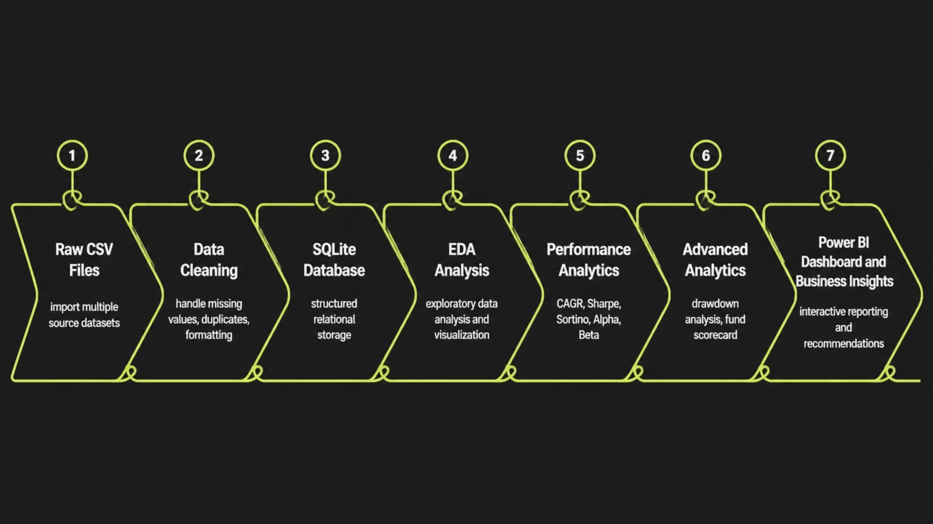
Project Architecture
The analytics pipeline follows a structured seven-stage workflow — from raw CSV ingestion through cleaning, database construction, exploratory analysis, performance modeling, and finally interactive visualization in Power BI. Each stage builds on the previous, ensuring data integrity and analytical rigor.

Slide 5
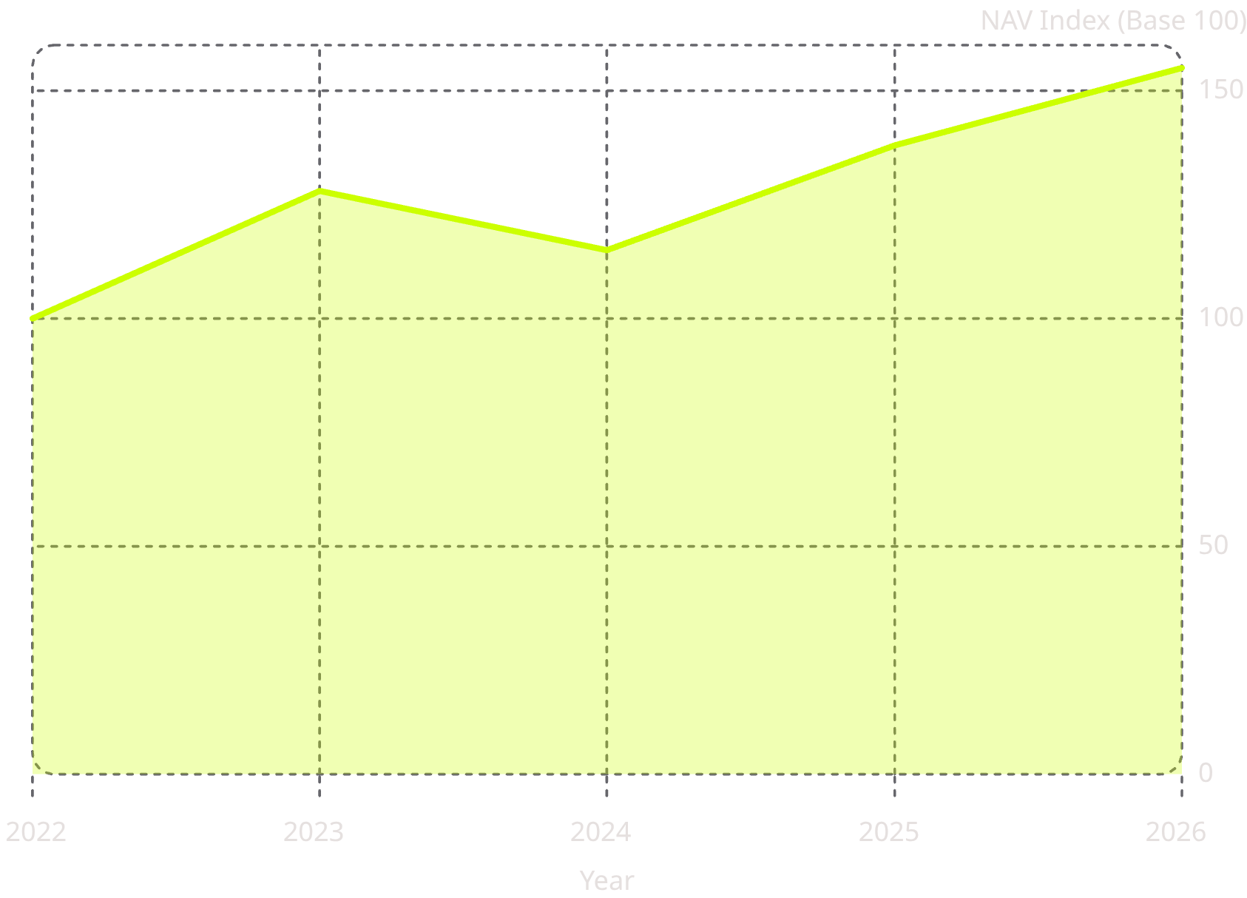
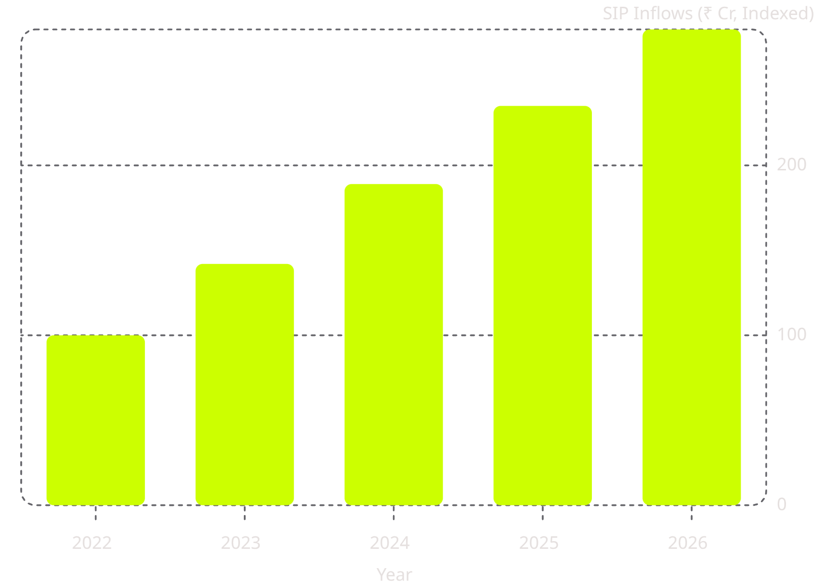
EDA Highlights — NAV & SIP Trends
Exploratory data analysis revealed clear market momentum patterns across the study period. NAV growth peaked in 2023, while 2024 introduced visible corrections — a pattern consistent with broader market volatility. SIP inflows demonstrated remarkable consistency, underscoring growing investor confidence in systematic investing.
NAV Trend Analysis
Monthly SIP Inflow Trend
NAV index shows strong 2023 growth, a 2024 correction, and recovery through 2026.
SIP inflows grew consistently year-over-year, reflecting sustained investor adoption.

Slide 6
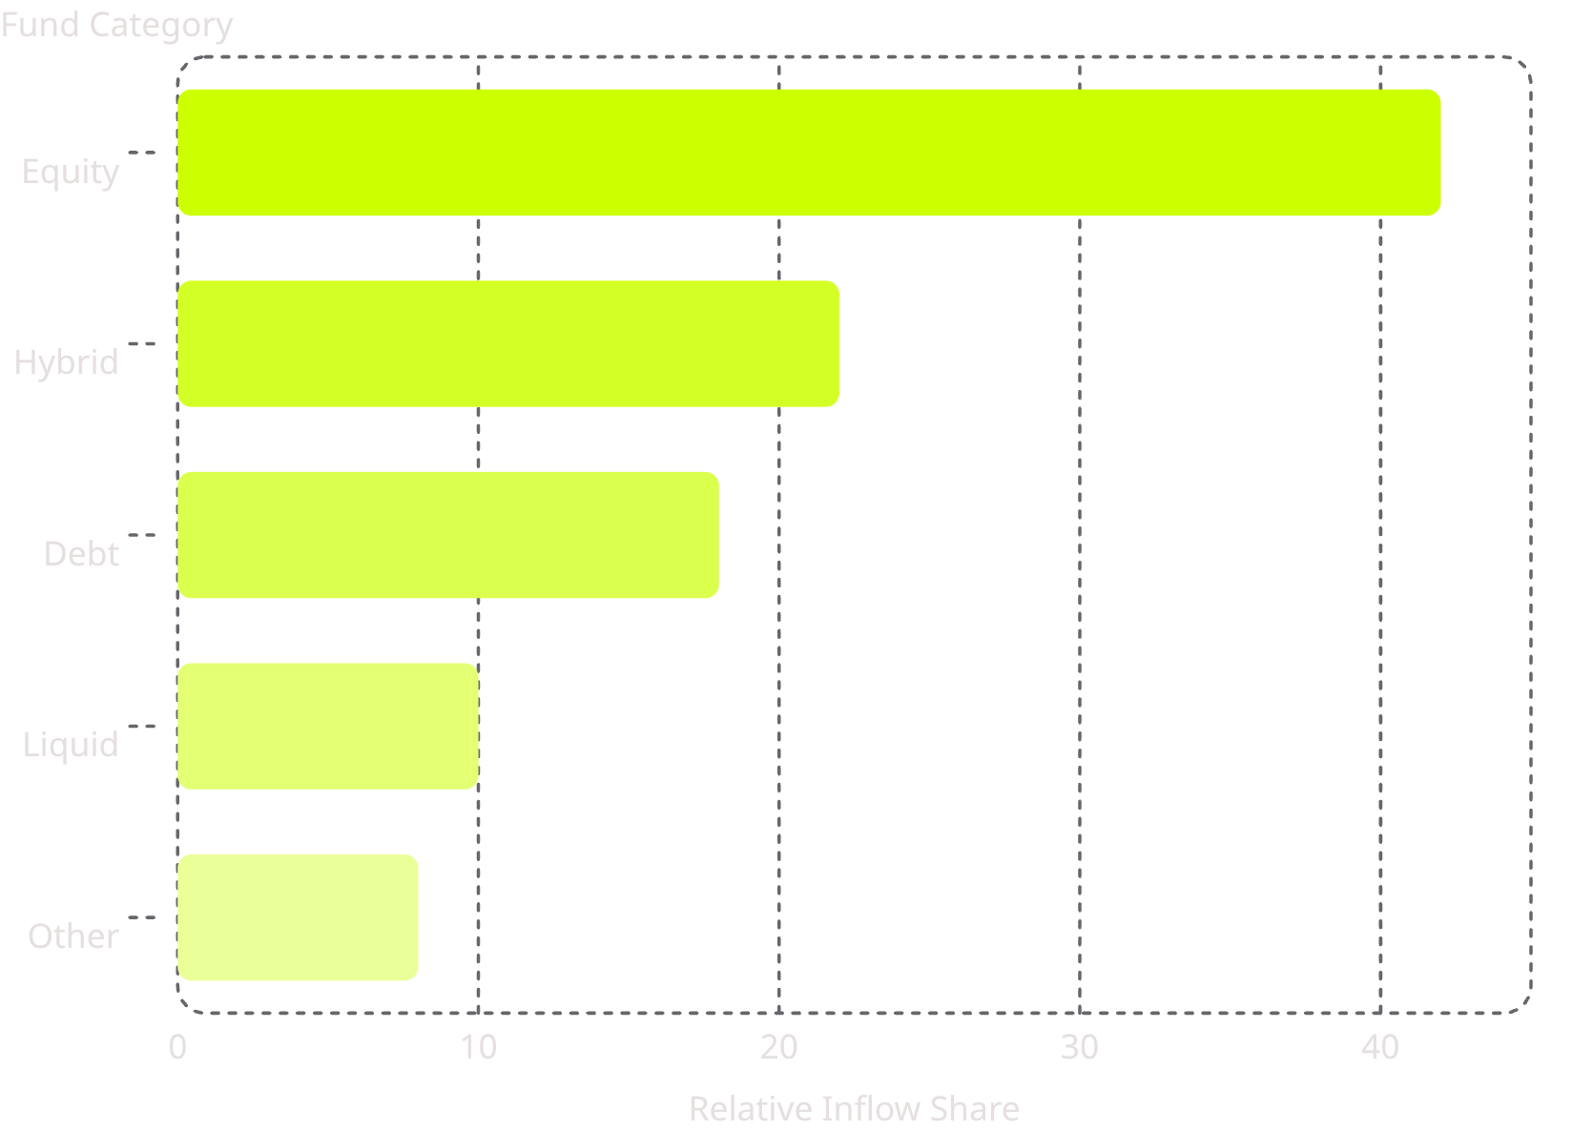
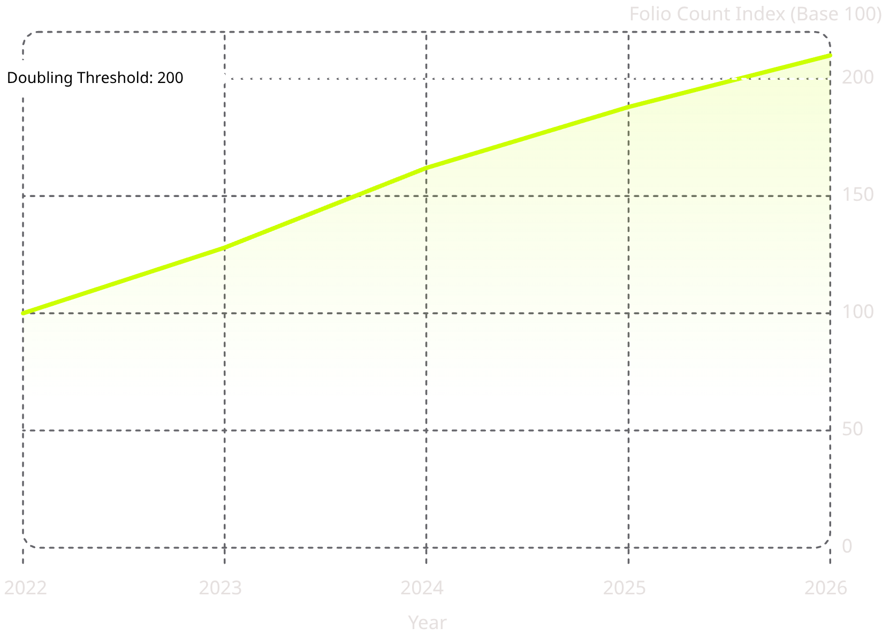
EDA Highlights — Category Flows & Folio Growth
Equity categories dominated fund inflows throughout the analysis period, reflecting strong risk appetite among retail and institutional investors. Investor participation surged dramatically — folio count nearly doubled between 2022 and 2026, signaling a structural shift toward formal investment channels in India.
Category Inflow Distribution
Folio Count Growth (Indexed)
Equity funds captured the largest share of total inflows across all categories.
Folio count crossed the doubling threshold by 2026, confirming expanding investor base.

Slide 7

Performance Analytics — Risk-Adjusted Returns
Three core metrics were used to evaluate fund performance beyond raw returns. CAGR captures compounded growth over the holding period. The Sharpe Ratio measures excess return per unit of total risk. The Sortino Ratio refines this by penalizing only downside volatility — a more investor-relevant measure.
CAGR — Wealth Creation Potential
Sharpe Ratio — Risk Efficiency
Sortino Ratio — Downside Protection
Top-performing equity funds demonstrated strong long-term CAGR, confirming the power of disciplined, long-horizon investing in growth-oriented schemes.
Funds with higher Sharpe Ratios delivered superior returns relative to the risk taken, outperforming peers on a risk-adjusted basis even when absolute returns were similar.
Sortino analysis highlighted funds that minimized harmful volatility while preserving upside — a critical differentiator for conservative and moderate investors.

Slide 8
Performance Analytics — Alpha, Beta & Drawdown
Advanced metrics provided a deeper view of fund manager skill and downside resilience. Alpha measures outperformance relative to the benchmark. Beta quantifies market sensitivity. Maximum Drawdown reveals the largest peak-to-trough decline — a key stress indicator. A composite Fund Scorecard integrated all metrics into a unified ranking.
68%
1.1x
Funds with Positive Alpha
Average Beta (Equity)
Of analyzed equity funds generated alpha above their respective benchmarks.
Equity funds showed slightly higher market sensitivity, typical for growth-oriented strategies.
18%
10
Max Drawdown (Avg)
Fund Scorecard Factors
Average maximum drawdown across top equity funds during the 2024 correction period.
Composite ranking methodology incorporating returns, risk, consistency, and benchmark outperformance.

Slide 9
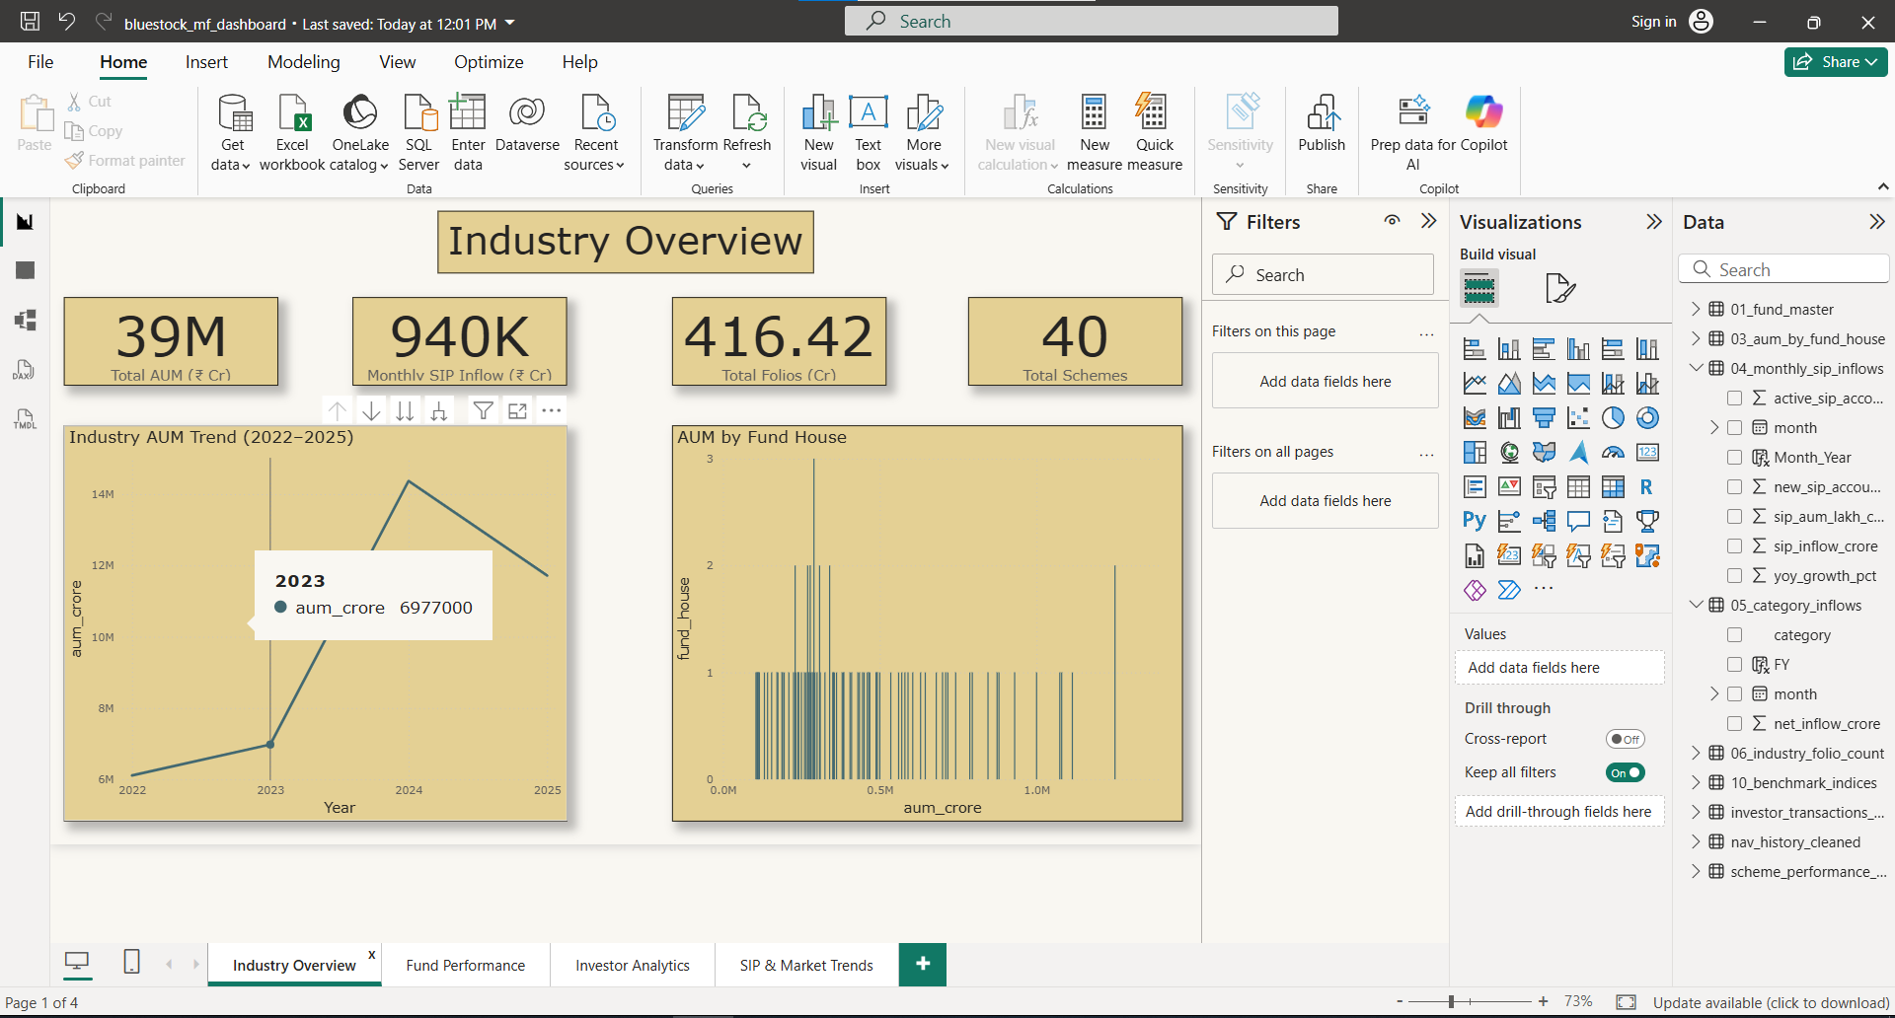
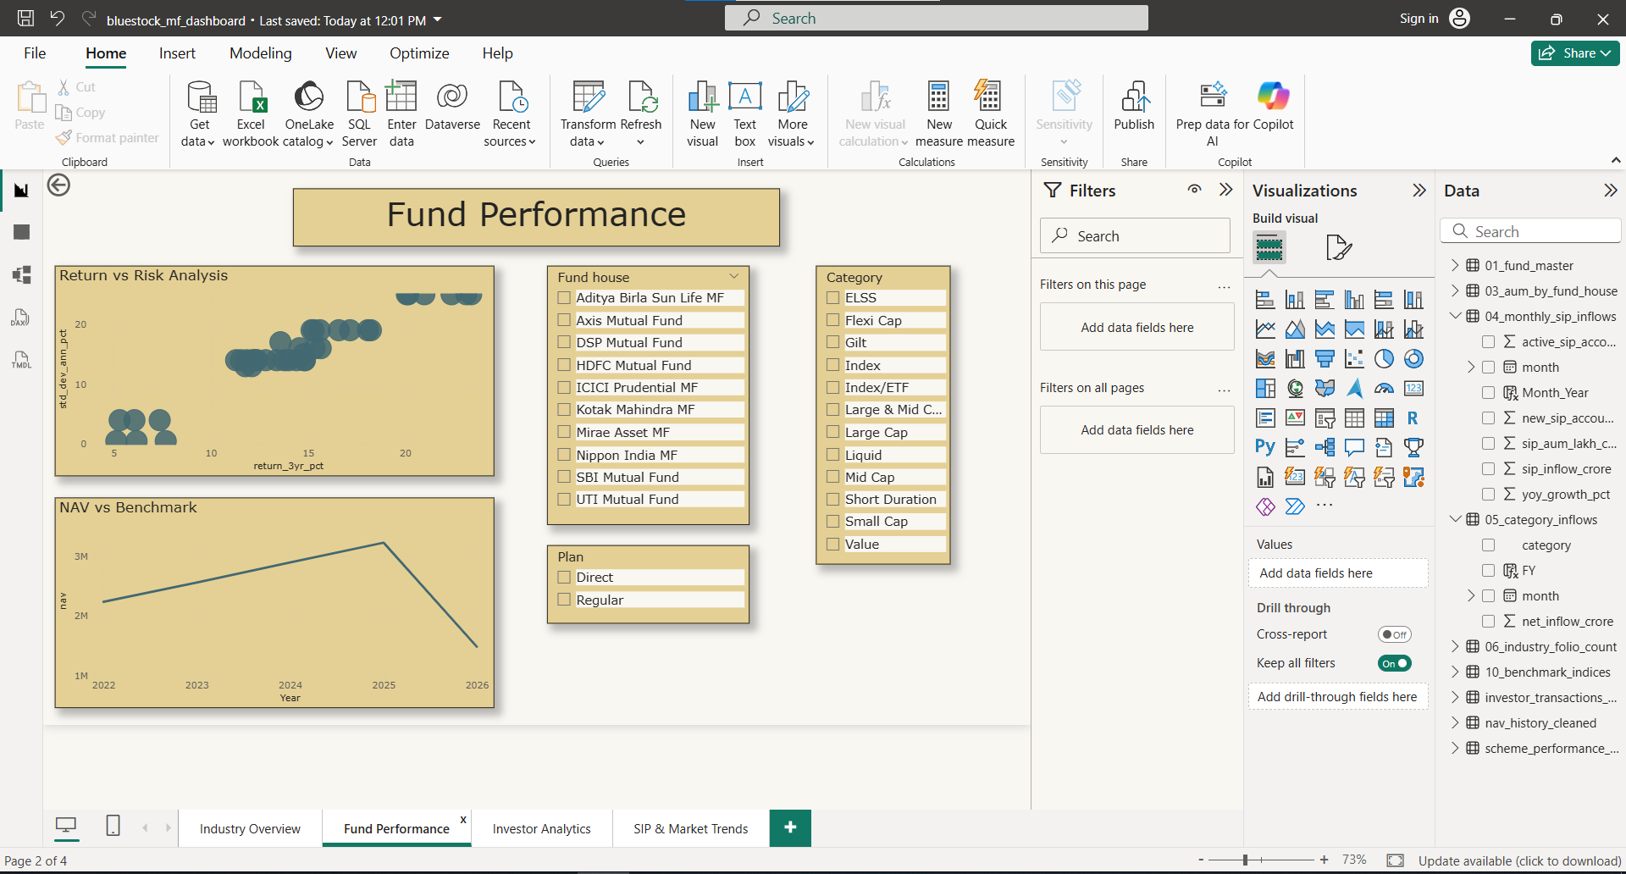
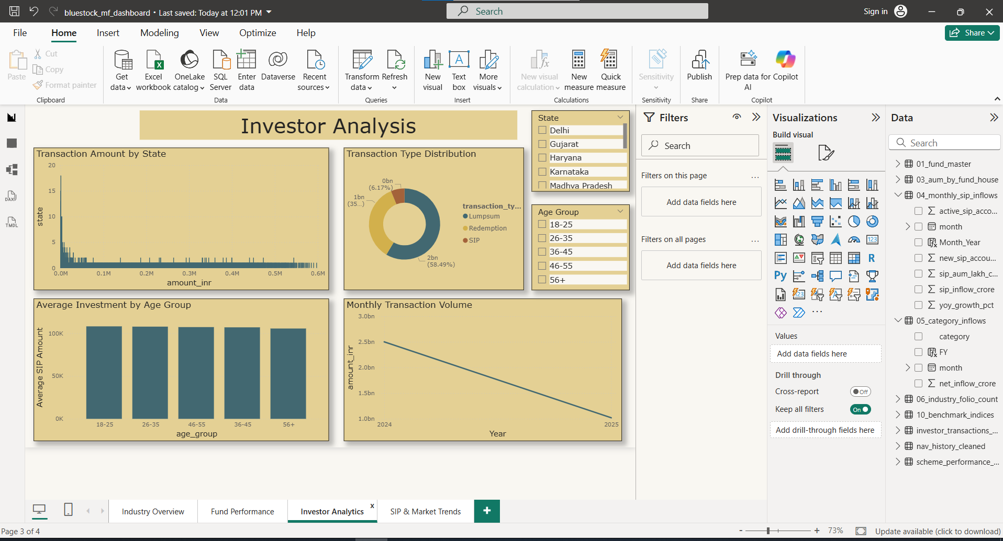
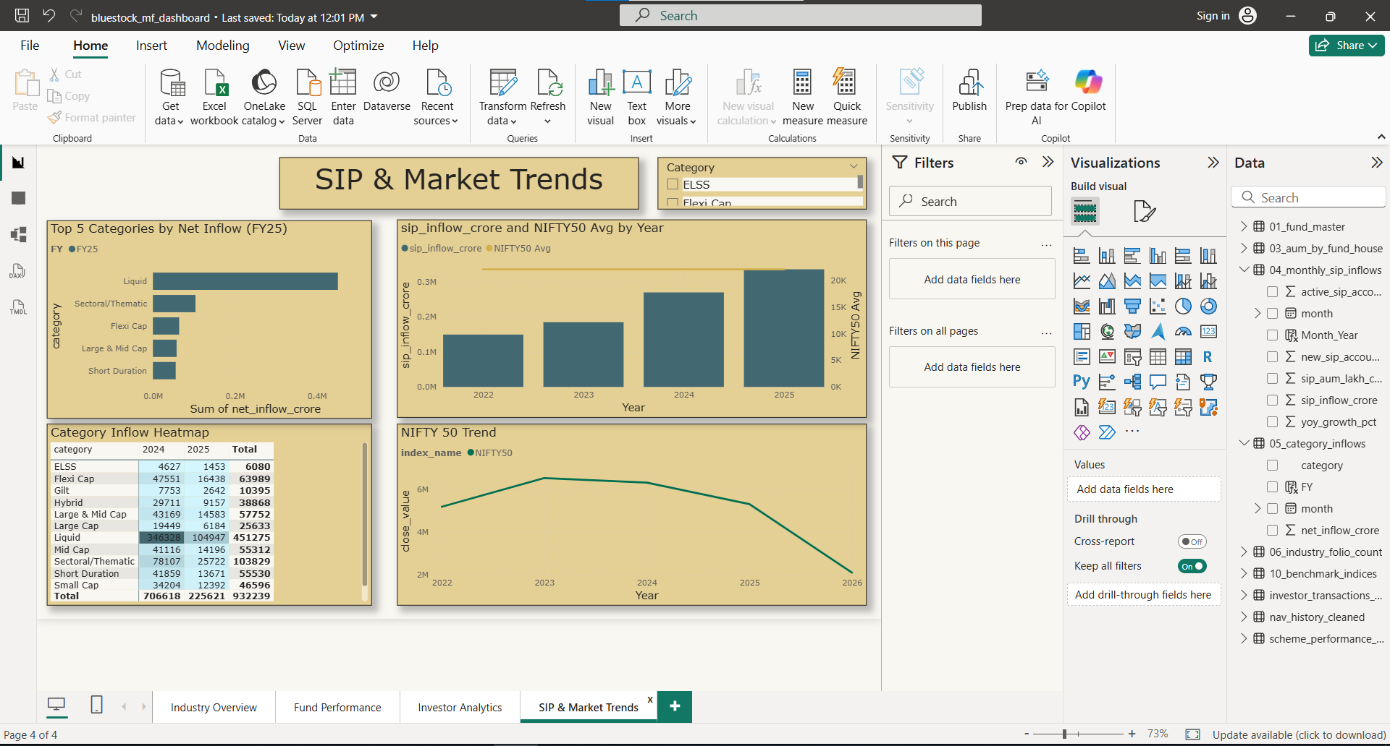
Power BI Dashboard Overview
Four interactive dashboard pages were developed in Power BI, each serving a distinct analytical purpose. Together, they enable stakeholders to explore industry trends, compare fund performance, analyze investor behavior, and track SIP and market dynamics — all from a single, cohesive reporting environment.
Industry Overview
Fund Performance
Investor Analytics
SIP & Market Trends
High-level AUM trends, category-wise inflows, and market-wide folio growth at a glance.
Side-by-side fund comparisons with CAGR, Sharpe, Sortino, and benchmark-relative metrics.
Folio count trends, transaction patterns, and investor participation metrics by category.
Monthly SIP inflow trajectories, NAV movements, and category-level flow analysis over time.

Slide 10

Key Findings & Recommendations
Key Findings
Strategic Recommendations
Mutual fund AUM grew significantly across the 2022–2026 period
SIP adoption increased continuously, reflecting behavioral change
Equity funds attracted the maximum share of total inflows
Risk-adjusted metrics (Sharpe, Sortino) provided superior fund evaluation vs. returns alone
Folio count nearly doubled, signaling broadening investor participation
Diversify portfolios across equity, hybrid, and debt categories to manage risk
Use Sharpe Ratio alongside CAGR when comparing funds — returns without risk context are incomplete
Maintain SIP discipline for long-term wealth creation; consistency outperforms timing
Monitor drawdown metrics to understand downside exposure before investing
Leverage dashboards for ongoing portfolio monitoring and rebalancing decisions
This capstone project demonstrates an end-to-end analytics workflow — from raw data to actionable investment intelligence — using industry-standard tools including SQLite, Python, and Power BI.
Thank you. Questions and discussion welcome. · Prepared by Hifza Tanveer · Bluestock Mutual Fund Analytics · BCA Final Year · 2026

Slide 11
THANK YOU

